Slide 1
Old English to Modern English Machine Translation
Aaron Jencks and Henlee Hull

Slide 2
Overview
What is Old English?
Methods
  Decision Trees
  Data Pre-Processing
Examples
Demonstration

Slide 3
What is Old English?

Slide 4
Old English
Spanned from roughly 450-1150
Ended with the Norman Conquest
Found mainly in Beowulf and copies of the bible
It’s not Shakespeare
An angin is ealra þinga, þæt is God Ælmihtig
There is one origin of all things, that is God Almighty

Slide 5
Methods

Slide 6
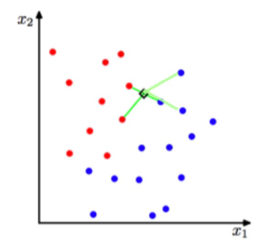
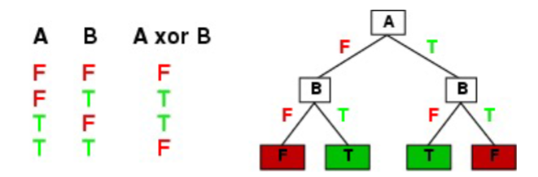
Decision Trees

Slide 7
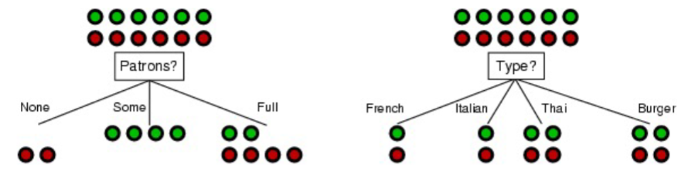
Uncertainty

Slide 8
85%
Accuracy

Slide 9
Data Pre-Processing

Slide 10
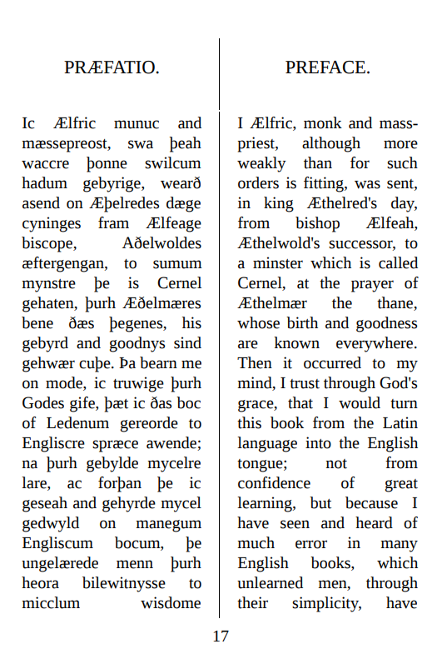
Finding a Corpus
The Homilies of the Anglo-Saxon Church

Slide 11
Step 1: Separate OE and NE
An angin is ealra þinga, þæt is God Ælmihtig. He is ordfruma and ende: he is ordfruma, forði þe he wæs æfre; he is ende butan ælcere geendunge, forðan þe he bið æfre ungeendod. He is ealra cyninga Cyning, and ealra hlaforda Hlaford. He hylt mid his mihte heofonas and eorðan, and ealle gesceafta butan geswince, and he besceawað þa niwelnyssa þe under þyssere eorðan sind. He awecð ealle duna mid anre handa, and ne mæg nan þing his willan wiðstandan. Ne mæg nan gesceaft fulfremedlice smeagan ne understandan ymbe god: Maran cyððe habbað englas to Gode þonne men, and þeah-hweðere hí ne magon fulfremedlice understandan ymbe God. Hé gesceop gesceafta þaða he wolde; þurh his wisdom he geworhte ealle þing, and þurh his willan hé hí ealle geliffæste. Ðeos þrynnys is án God, þæt is se Fæder and his wisdom of him sylfum æfre acenned; and heora begra willa, þæt is se Halga Gast: he nis na acenned, ac he gæð of þam Fæder and of þam Suna gelice. Ðas þry hadas sindon án Ælmihtig God, se geworhte heofenas, and eorðan, and ealle gesceafta. He gesceop tyn engla werod, þæt sind englas and heah-englas, throni, dominationes, principatus, potestates, uirtutes, cherubim, seraphim. Her sindon nigon engla werod: hí nabbað nænne lichaman, ac hí sindon ealle gastas swiðe strange and mihtige and wlitige, on micelre fægernysse gesceapene, to lofe and to wurðmynte heora Scyppende. Ðæt teoðe werod abreað and awende on yfel. God hí gesceop ealle góde, and let hí habban agenne cyre, swa hí heora Scyppend lufedon and filigdon, swa hí hine forleton. Ða wæs þæs teoðan werodes ealdor swiðe fæger and wlitig gesceapen, swa þæt hé wæs geháten Leohtberend. Þa began he to modigenne for þære fægernysse þe he hæfde, and cwæð on his heortan þæt hé wolde and eaðe mihte beon his Scyppende gelic, and sittan on þam norð-dæle heofenan rices, and habban andweald and rice ongean God Ælmihtigne. Þa gefæstnode he þisne ræd wið þæt werod þe hé bewiste, and hí ealle to ðam ræde gebugon. Ðaða hí ealle hæfdon þysne ræd betwux him gefæstnod, þa becom Godes grama ofer hí ealle, and hí ealle wurdon awende of þam fægeran híwe, þe hí on gesceapene wæron, to laðlicum deoflum. And swiðe rihtlice him swa getimode, þaða he wolde mid modignysse beon betera þonne he gesceapen wæs, and cwæð, þæt he mihte beon þam Ælmihtigum Gode gelíc. Þa wearð he and ealle his geferan forcuþran and wyrsan þonne ænig oðer gesceaft; and þa hwile þe he smeade hu he mihte dælan rice wið God, þa hwile gearcode se Ælmihtiga Scyppend him and his geferum helle wíte, and hí ealle adræfde of heofenan rices myrhðe, and let befeallan on þæt ece fyr, þe him gegearcod wæs for heora ofermettum. Þa sona þa nigon werod, þe ðær to lafe wæron, bugon to heora Scyppende mid ealre eaðmodnesse, and betæhton heora rǽd to his willan. Þa getrymde se Ælmihtiga God þa nigon engla werod, and gestaþelfæste swa þæt hí næfre ne mihton ne noldon syððan fram his willan gebugan; ne hí ne magon nu, ne hí nellað nane synne gewyrcan, ac hi æfre beoð ymbe þæt án, hu hi magon Gode gehyrsumian, and him gecweman. Swa mihton eac þa oðre þe ðær feollon dón, gif hi woldon; forþi ðe God hí geworhte to wlitegum engla gecynde, and let hí habban agenne cyre, and hí næfre ne gebigde ne ne nydde mid nanum þingum to þam yfelan ræde; ne næfre se yfela rǽd ne com of Godes geþance, ac com of þæs deofles, swa swa we ǽr cwædon. There is one origin of all things, that is God Almighty. He is beginning and end: he is beginning, because he was ever; he is end without any ending, because he is ever unended. He is King of all kings, and Lord of all lords. He holdeth with his might heavens, and earth, and all creatures, without toil, and he beholdeth the depths which are under this earth. He weigheth all hills with one hand, and no thing may withstand his will. No creature may perfectly search out nor understand concerning God: greater affinity have angels to God than men, and yet they may not perfectly understand concerning God. He created those creatures that he would; through his wisdom he wrought all things, and through his will he endued them all with life. This Trinity is one God, that is, the Father, and his Wisdom, of himself ever produced; and the Will of them both, that is, the Holy Ghost: he is not born, but he goeth alike from the Father and from the Son. These three persons are one Almighty God, who wrought the heavens, and the earth, and all creatures. He created ten hosts of angels, that is angels and archangels, throni, dominationes, principatus, potestates, virtutes, cherubim, seraphim. Here are nine hosts of angels: they have no body, but they are all spirits, very strong, and mighty, and beautiful, formed with great fairness, to the praise and glory of their Creator. The tenth host rebelled and turned to evil. God created them all good, and let them have their own discretion, whether they would love and follow their Creator, or would forsake him. Now the prince of the tenth host was formed very fair and beauteous, so that he was called 'Light-bearing' (Lucifer). Then he began to wax proud by reason of the comeliness that he had, and said in his heart that he would and easily might be equal to his Creator, and sit in the north part of heaven's kingdom, and have power and sway against God Almighty. Then he confirmed this resolve with the host over which he ruled, and they all bowed to that resolve. When they all had confirmed this resolve among themselves, God's anger came over them all, and they were all changed from the fair form in which they were created to loathly devils. And very rightly it so befell him, when he would in pride be better than he was created, and said that he might be equal to Almighty God. Then became he and all his associates more wicked and worse than any other creatures; and while he meditated how he might share power with God, the Almighty Creator prepared hell-torment for him and his associates, and drove them all from the joy of heaven's kingdom, and caused them to fall into the eternal fire that was prepared for them for their pride. Then forthwith the nine hosts that were left bowed to their Creator with all humbleness, and resigned their purpose to his will. Then the Almighty God confirmed and established the nine hosts of angels, so that they never might or would afterwards swerve from his will; nor can they now perpetrate any sin, but they are ever meditating only how they may obey God and be acceptable to him. So might also the others who fell have done if they had been willing; seeing that God had made them of the beauteous nature of angels, and let them have their own will, and would never have inclined nor forced them in any way to that evil counsel; for the evil counsel never came from God's conception, but came from the devil's, as we before said.
An angin is ealra þinga, þæt is God Ælmihtig. He is ordfruma and ende: he is ordfruma, forði þe he wæs æfre; he is ende butan ælcere geendunge, forðan þe he bið æfre ungeendod. He is ealra cyninga Cyning, and ealra hlaforda Hlaford. He hylt mid his mihte heofonas and eorðan, and ealle gesceafta butan geswince, and he besceawað þa niwelnyssa þe under þyssere eorðan sind. He awecð ealle duna mid anre handa, and ne mæg nan þing his willan wiðstandan. Ne mæg nan gesceaft fulfremedlice smeagan ne understandan ymbe god: Maran cyððe habbað englas to Gode þonne men, and þeah-hweðere hí ne magon fulfremedlice understandan ymbe God. Hé gesceop gesceafta þaða he wolde; þurh his wisdom he geworhte ealle þing, and þurh his willan hé hí ealle geliffæste. Ðeos þrynnys is án God, þæt is se Fæder and his wisdom of him sylfum æfre acenned; and heora begra willa, þæt is se Halga Gast: he nis na acenned, ac he gæð of þam Fæder and of þam Suna gelice. Ðas þry hadas sindon án Ælmihtig God, se geworhte heofenas, and eorðan, and ealle gesceafta. He gesceop tyn engla werod, þæt sind englas and heah-englas, throni, dominationes, principatus, potestates, uirtutes, cherubim, seraphim. Her sindon nigon engla werod: hí nabbað nænne lichaman, ac hí sindon ealle gastas swiðe strange and mihtige and wlitige, on micelre fægernysse gesceapene, to lofe and to wurðmynte heora Scyppende. Ðæt teoðe werod abreað and awende on yfel. God hí gesceop ealle góde, and let hí habban agenne cyre, swa hí heora Scyppend lufedon and filigdon, swa hí hine forleton. Ða wæs þæs teoðan werodes ealdor swiðe fæger and wlitig gesceapen, swa þæt hé wæs geháten Leohtberend. Þa began he to modigenne for þære fægernysse þe he hæfde, and cwæð on his heortan þæt hé wolde and eaðe mihte beon his Scyppende gelic, and sittan on þam norð-dæle heofenan rices, and habban andweald and rice ongean God Ælmihtigne. Þa gefæstnode he þisne ræd wið þæt werod þe hé bewiste, and hí ealle to ðam ræde gebugon. Ðaða hí ealle hæfdon þysne ræd betwux him gefæstnod, þa becom Godes grama ofer hí ealle, and hí ealle wurdon awende of þam fægeran híwe, þe hí on gesceapene wæron, to laðlicum deoflum. And swiðe rihtlice him swa getimode, þaða he wolde mid modignysse beon betera þonne he gesceapen wæs, and cwæð, þæt he mihte beon þam Ælmihtigum Gode gelíc. Þa wearð he and ealle his geferan forcuþran and wyrsan þonne ænig oðer gesceaft; and þa hwile þe he smeade hu he mihte dælan rice wið God, þa hwile gearcode se Ælmihtiga Scyppend him and his geferum helle wíte, and hí ealle adræfde of heofenan rices myrhðe, and let befeallan on þæt ece fyr, þe him gegearcod wæs for heora ofermettum. Þa sona þa nigon werod, þe ðær to lafe wæron, bugon to heora Scyppende mid ealre eaðmodnesse, and betæhton heora rǽd to his willan. Þa getrymde se Ælmihtiga God þa nigon engla werod, and gestaþelfæste swa þæt hí næfre ne mihton ne noldon syððan fram his willan gebugan; ne hí ne magon nu, ne hí nellað nane synne gewyrcan, ac hi æfre beoð ymbe þæt án, hu hi magon Gode gehyrsumian, and him gecweman. Swa mihton eac þa oðre þe ðær feollon dón, gif hi woldon; forþi ðe God hí geworhte to wlitegum engla gecynde, and let hí habban agenne cyre, and hí næfre ne gebigde ne ne nydde mid nanum þingum to þam yfelan ræde; ne næfre se yfela rǽd ne com of Godes geþance, ac com of þæs deofles, swa swa we ǽr cwædon.
There is one origin of all things, that is God Almighty. He is beginning and end: he is beginning, because he was ever; he is end without any ending, because he is ever unended. He is King of all kings, and Lord of all lords. He holdeth with his might heavens, and earth, and all creatures, without toil, and he beholdeth the depths which are under this earth. He weigheth all hills with one hand, and no thing may withstand his will. No creature may perfectly search out nor understand concerning God: greater affinity have angels to God than men, and yet they may not perfectly understand concerning God. He created those creatures that he would; through his wisdom he wrought all things, and through his will he endued them all with life. This Trinity is one God, that is, the Father, and his Wisdom, of himself ever produced; and the Will of them both, that is, the Holy Ghost: he is not born, but he goeth alike from the Father and from the Son. These three persons are one Almighty God, who wrought the heavens, and the earth, and all creatures. He created ten hosts of angels, that is angels and archangels, throni, dominationes, principatus, potestates, virtutes, cherubim, seraphim. Here are nine hosts of angels: they have no body, but they are all spirits, very strong, and mighty, and beautiful, formed with great fairness, to the praise and glory of their Creator. The tenth host rebelled and turned to evil. God created them all good, and let them have their own discretion, whether they would love and follow their Creator, or would forsake him. Now the prince of the tenth host was formed very fair and beauteous, so that he was called 'Light-bearing' (Lucifer). Then he began to wax proud by reason of the comeliness that he had, and said in his heart that he would and easily might be equal to his Creator, and sit in the north part of heaven's kingdom, and have power and sway against God Almighty. Then he confirmed this resolve with the host over which he ruled, and they all bowed to that resolve. When they all had confirmed this resolve among themselves, God's anger came over them all, and they were all changed from the fair form in which they were created to loathly devils. And very rightly it so befell him, when he would in pride be better than he was created, and said that he might be equal to Almighty God. Then became he and all his associates more wicked and worse than any other creatures; and while he meditated how he might share power with God, the Almighty Creator prepared hell-torment for him and his associates, and drove them all from the joy of heaven's kingdom, and caused them to fall into the eternal fire that was prepared for them for their pride. Then forthwith the nine hosts that were left bowed to their Creator with all humbleness, and resigned their purpose to his will. Then the Almighty God confirmed and established the nine hosts of angels, so that they never might or would afterwards swerve from his will; nor can they now perpetrate any sin, but they are ever meditating only how they may obey God and be acceptable to him. So might also the others who fell have done if they had been willing; seeing that God had made them of the beauteous nature of angels, and let them have their own will, and would never have inclined nor forced them in any way to that evil counsel; for the evil counsel never came from God's conception, but came from the devil's, as we before said.

Slide 12
Step 2: Separate Sentences
An angin is ealra þinga, þæt is God Ælmihtig. He is ordfruma and ende: he is ordfruma, forði þe he wæs æfre; he is ende butan ælcere geendunge, forðan þe he bið æfre ungeendod. He is ealra cyninga Cyning, and ealra hlaforda Hlaford. He hylt mid his mihte heofonas and eorðan, and ealle gesceafta butan geswince, and he besceawað þa niwelnyssa þe under þyssere eorðan sind. He awecð ealle duna mid anre handa, and ne mæg nan þing his willan wiðstandan. Ne mæg nan gesceaft fulfremedlice smeagan ne understandan ymbe god: Maran cyððe habbað englas to Gode þonne men, and þeah-hweðere hí ne magon fulfremedlice understandan ymbe God. Hé gesceop gesceafta þaða he wolde; þurh his wisdom he geworhte ealle þing, and þurh his willan hé hí ealle geliffæste. Ðeos þrynnys is án God, þæt is se Fæder and his wisdom of him sylfum æfre acenned; and heora begra willa, þæt is se Halga Gast: he nis na acenned, ac he gæð of þam Fæder and of þam Suna gelice. Ðas þry hadas sindon án Ælmihtig God, se geworhte heofenas, and eorðan, and ealle gesceafta. He gesceop tyn engla werod, þæt sind englas and heah-englas, throni, dominationes, principatus, potestates, uirtutes, cherubim, seraphim. Her sindon nigon engla werod: hí nabbað nænne lichaman, ac hí sindon ealle gastas swiðe strange and mihtige and wlitige, on micelre fægernysse gesceapene, to lofe and to wurðmynte heora Scyppende. Ðæt teoðe werod abreað and awende on yfel. God hí gesceop ealle góde, and let hí habban agenne cyre, swa hí heora Scyppend lufedon and filigdon, swa hí hine forleton. Ða wæs þæs teoðan werodes ealdor swiðe fæger and wlitig gesceapen, swa þæt hé wæs geháten Leohtberend. Þa began he to modigenne for þære fægernysse þe he hæfde, and cwæð on his heortan þæt hé wolde and eaðe mihte beon his Scyppende gelic, and sittan on þam norð-dæle heofenan rices, and habban andweald and rice ongean God Ælmihtigne. Þa gefæstnode he þisne ræd wið þæt werod þe hé bewiste, and hí ealle to ðam ræde gebugon. Ðaða hí ealle hæfdon þysne ræd betwux him gefæstnod, þa becom Godes grama ofer hí ealle, and hí ealle wurdon awende of þam fægeran híwe, þe hí on gesceapene wæron, to laðlicum deoflum. And swiðe rihtlice him swa getimode, þaða he wolde mid modignysse beon betera þonne he gesceapen wæs, and cwæð, þæt he mihte beon þam Ælmihtigum Gode gelíc. Þa wearð he and ealle his geferan forcuþran and wyrsan þonne ænig oðer gesceaft; and þa hwile þe he smeade hu he mihte dælan rice wið God, þa hwile gearcode se Ælmihtiga Scyppend him and his geferum helle wíte, and hí ealle adræfde of heofenan rices myrhðe, and let befeallan on þæt ece fyr, þe him gegearcod wæs for heora ofermettum. Þa sona þa nigon werod, þe ðær to lafe wæron, bugon to heora Scyppende mid ealre eaðmodnesse, and betæhton heora rǽd to his willan. Þa getrymde se Ælmihtiga God þa nigon engla werod, and gestaþelfæste swa þæt hí næfre ne mihton ne noldon syððan fram his willan gebugan; ne hí ne magon nu, ne hí nellað nane synne gewyrcan, ac hi æfre beoð ymbe þæt án, hu hi magon Gode gehyrsumian, and him gecweman. Swa mihton eac þa oðre þe ðær feollon dón, gif hi woldon; forþi ðe God hí geworhte to wlitegum engla gecynde, and let hí habban agenne cyre, and hí næfre ne gebigde ne ne nydde mid nanum þingum to þam yfelan ræde; ne næfre se yfela rǽd ne com of Godes geþance, ac com of þæs deofles, swa swa we ǽr cwædon.
There is one origin of all things, that is God Almighty. He is beginning and end: he is beginning, because he was ever; he is end without any ending, because he is ever unended. He is King of all kings, and Lord of all lords. He holdeth with his might heavens, and earth, and all creatures, without toil, and he beholdeth the depths which are under this earth. He weigheth all hills with one hand, and no thing may withstand his will. No creature may perfectly search out nor understand concerning God: greater affinity have angels to God than men, and yet they may not perfectly understand concerning God. He created those creatures that he would; through his wisdom he wrought all things, and through his will he endued them all with life. This Trinity is one God, that is, the Father, and his Wisdom, of himself ever produced; and the Will of them both, that is, the Holy Ghost: he is not born, but he goeth alike from the Father and from the Son. These three persons are one Almighty God, who wrought the heavens, and the earth, and all creatures. He created ten hosts of angels, that is angels and archangels, throni, dominationes, principatus, potestates, virtutes, cherubim, seraphim. Here are nine hosts of angels: they have no body, but they are all spirits, very strong, and mighty, and beautiful, formed with great fairness, to the praise and glory of their Creator. The tenth host rebelled and turned to evil. God created them all good, and let them have their own discretion, whether they would love and follow their Creator, or would forsake him. Now the prince of the tenth host was formed very fair and beauteous, so that he was called 'Light-bearing' (Lucifer). Then he began to wax proud by reason of the comeliness that he had, and said in his heart that he would and easily might be equal to his Creator, and sit in the north part of heaven's kingdom, and have power and sway against God Almighty. Then he confirmed this resolve with the host over which he ruled, and they all bowed to that resolve. When they all had confirmed this resolve among themselves, God's anger came over them all, and they were all changed from the fair form in which they were created to loathly devils. And very rightly it so befell him, when he would in pride be better than he was created, and said that he might be equal to Almighty God. Then became he and all his associates more wicked and worse than any other creatures; and while he meditated how he might share power with God, the Almighty Creator prepared hell-torment for him and his associates, and drove them all from the joy of heaven's kingdom, and caused them to fall into the eternal fire that was prepared for them for their pride. Then forthwith the nine hosts that were left bowed to their Creator with all humbleness, and resigned their purpose to his will. Then the Almighty God confirmed and established the nine hosts of angels, so that they never might or would afterwards swerve from his will; nor can they now perpetrate any sin, but they are ever meditating only how they may obey God and be acceptable to him. So might also the others who fell have done if they had been willing; seeing that God had made them of the beauteous nature of angels, and let them have their own will, and would never have inclined nor forced them in any way to that evil counsel; for the evil counsel never came from God's conception, but came from the devil's, as we before said.
An angin is ealra þinga, þæt is God Ælmihtig
There is one origin of all things, that is God Almighty
He is ordfruma and ende: he is ordfruma, forði þe he wæs æfre
He is beginning and end: he is beginning, because he was ever
he is ende butan ælcere geendunge, forðan þe he bið æfre ungeendod
he is end without any ending, because he is ever unended
He is ealra cyninga Cyning, and ealra hlaforda Hlaford
He is King of all kings, and Lord of all lords
...

Slide 13
Step 3: Index Corresponding Words
An angin is ealra þinga, þæt is God Ælmihtig
There is one origin of all things, that is God Almighty
An angin is ealra þinga, þæt is God Ælmihtig
There is one origin of all things, that is God Almighty
1 2 2 0 3 1 6 4 7 5 8 6 9 7 10 8

Slide 14
Examples

Slide 15
Examples
An angin is ealra þinga, þæt is God Ælmihtig
There is one origin of all things, that is God Almighty
Hwær Gif ane mihtige Gif ealle ða Þæt Gif Gode Ælmihtiga.

Slide 16
Demonstration

